Slide 1

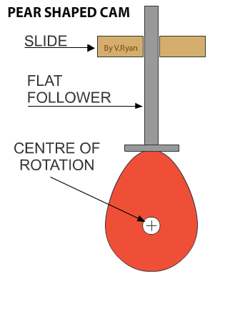
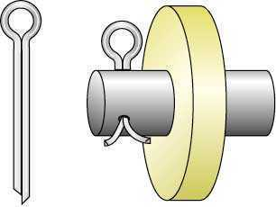

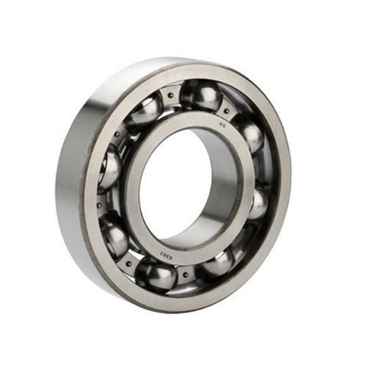
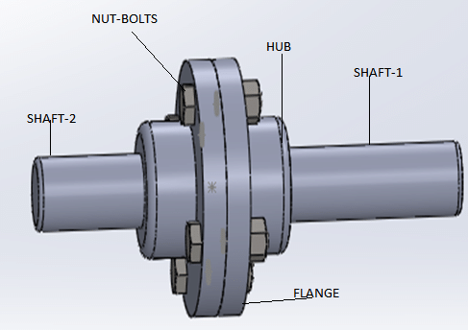
RME Lab – 1
Mechanical Components – 2
FY – DESH – VIT
Vishwakarma Institute of Technology
FY - Department of Engineering, Sciences and Humanities

Slide 2
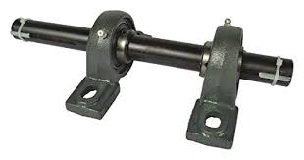
Mechanical Components
What is a shaft ?
What is a bearing ?
Why Bearings are required ?
Shafts are members which rotate and transmit power or motion.
Shafts are generally circular in cross section.
Vishwakarma Institute of Technology
FY - Department of Engineering, Sciences and Humanities
Shaft
Shafts need a support from both sides for smooth rotation. Bearings provide support to the shaft.
Bearings

Slide 3
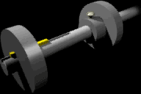
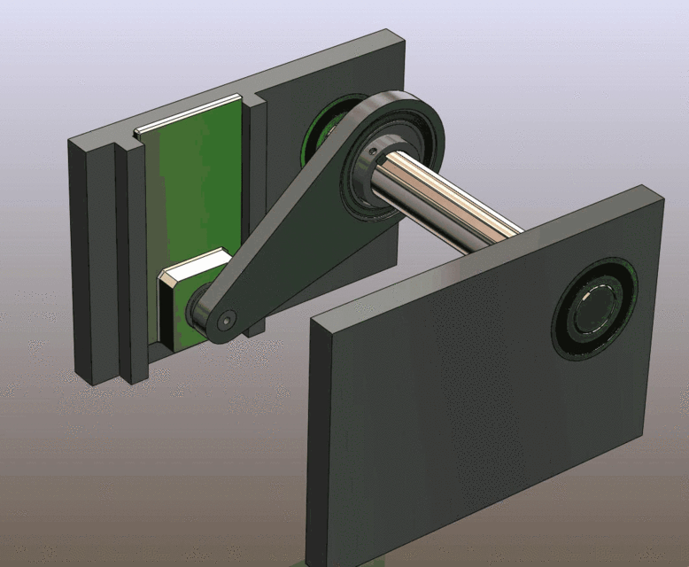
Mechanical Components
Shaft
Vishwakarma Institute of Technology
FY - Department of Engineering, Sciences and Humanities
Bearings

Slide 4
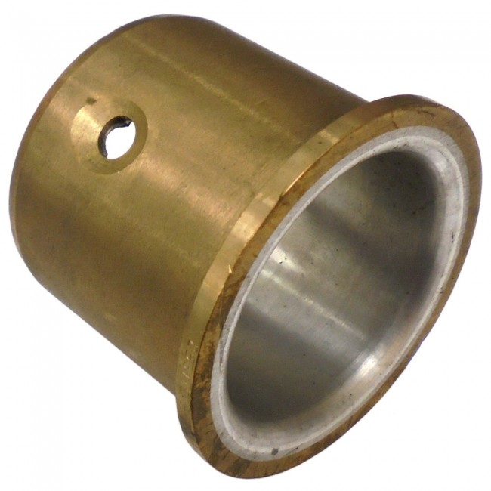
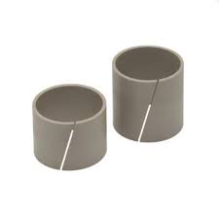
Mechanical Components
1) Simple Bush Bearing and 2) Simple Bush Bearing with a cut
Vishwakarma Institute of Technology
FY - Department of Engineering, Sciences and Humanities

Slide 5
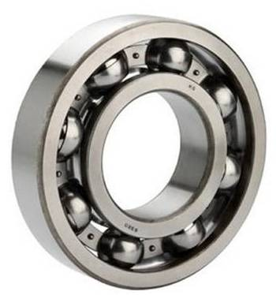
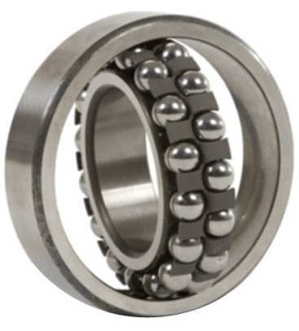
Mechanical Components
1) Single Ball Bearing and 2) Double Ball Bearing
Vishwakarma Institute of Technology
FY - Department of Engineering, Sciences and Humanities

Slide 6
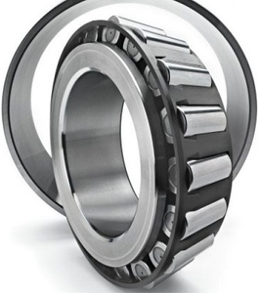
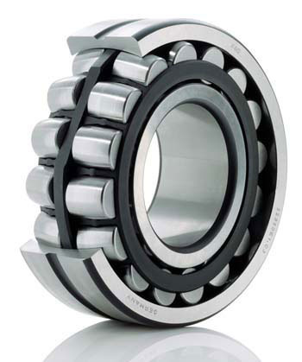
Mechanical Components
1) Taper Roller Bearing and 2) Double Taper Roller Bearing
Vishwakarma Institute of Technology
FY - Department of Engineering, Sciences and Humanities

Slide 7
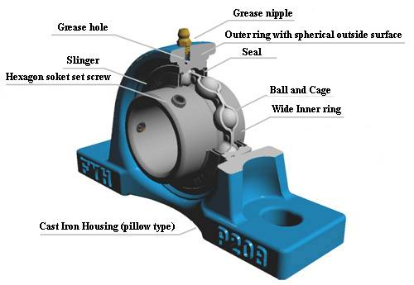
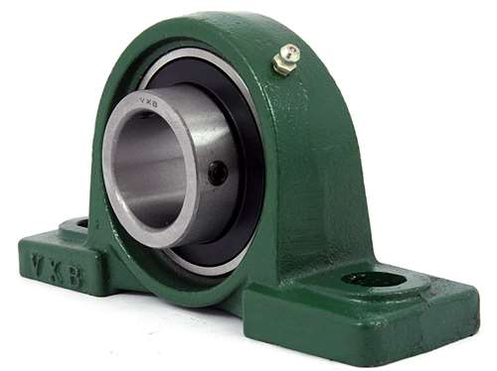

Mechanical Components
Vishwakarma Institute of Technology
FY - Department of Engineering, Sciences and Humanities
Bearing Block holds the bearing and supports the shaft.

Slide 8
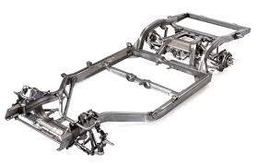
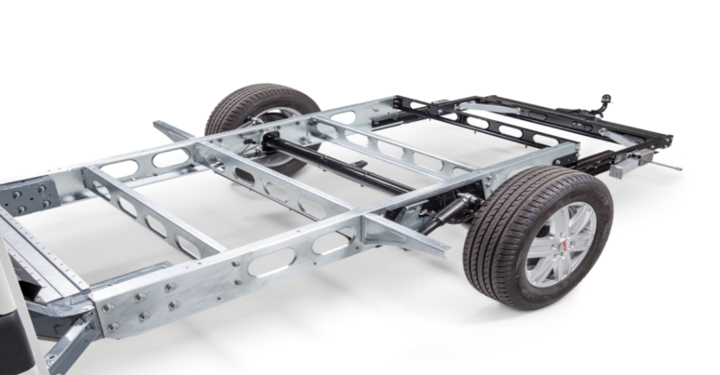
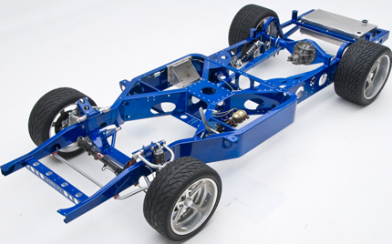
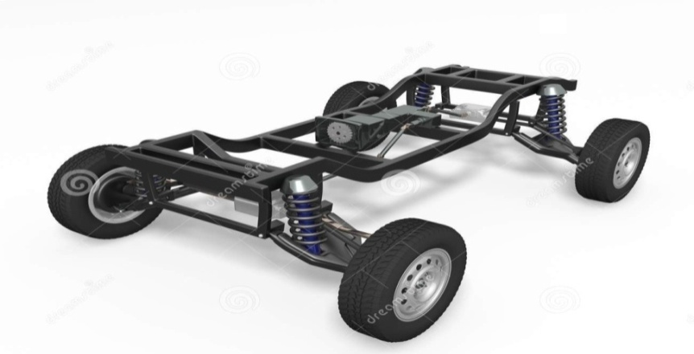
Mechanical Components
Different Chassis – the metal frame on which a Car is built
Vishwakarma Institute of Technology
FY - Department of Engineering, Sciences and Humanities

Slide 9
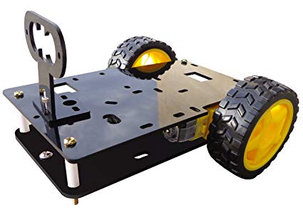
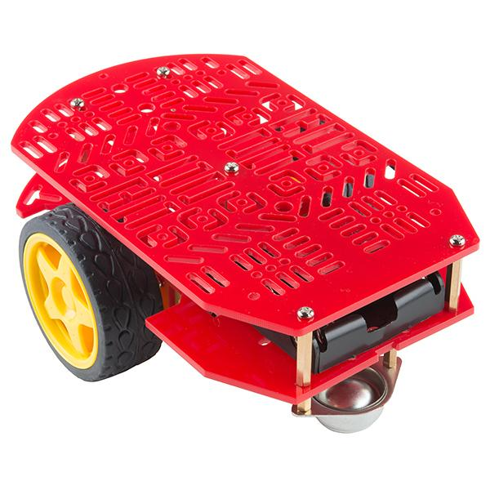
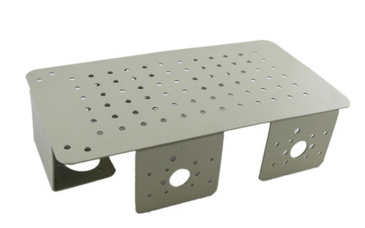
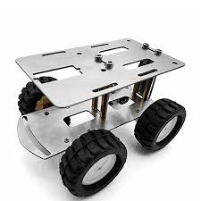
Mechanical Components
Different Chassis for Mobile Robots
Vishwakarma Institute of Technology
FY - Department of Engineering, Sciences and Humanities

Slide 10
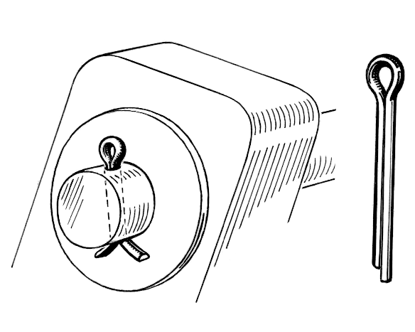
Mechanical Components
Cotter Pin
Vishwakarma Institute of Technology
FY - Department of Engineering, Sciences and Humanities

Slide 11
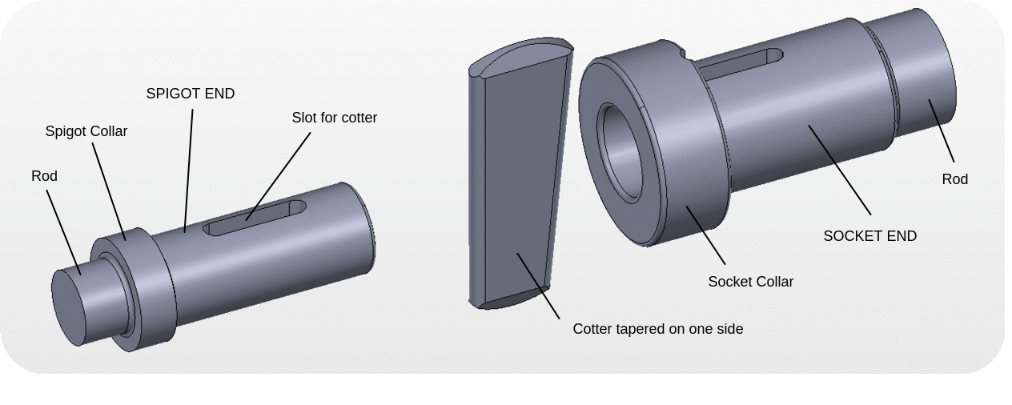
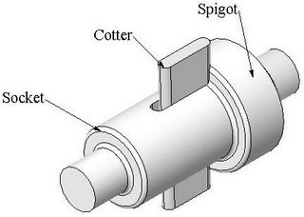
Mechanical Components
Cotter Joint
Vishwakarma Institute of Technology
FY - Department of Engineering, Sciences and Humanities

Slide 12
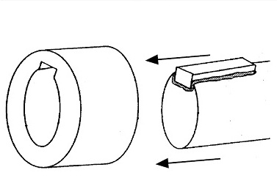
Mechanical Components
Shaft – Key – Key way
Vishwakarma Institute of Technology
FY - Department of Engineering, Sciences and Humanities

Slide 13
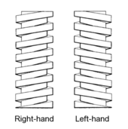
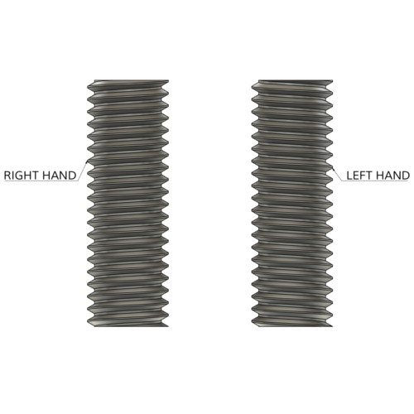
Mechanical Components
Left and Right hand threads
Vishwakarma Institute of Technology
FY - Department of Engineering, Sciences and Humanities

Slide 14
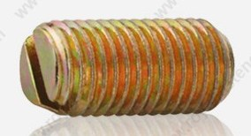
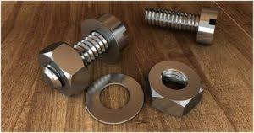
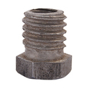
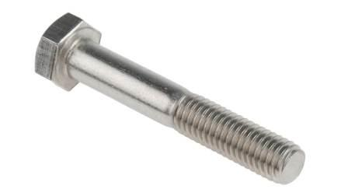
Mechanical Components
Identify these components
4
1
5
2
Vishwakarma Institute of Technology
FY - Department of Engineering, Sciences and Humanities
3
6
7

Slide 15
Mechanical Components
Working of a Cam
It converts Rotary Motion to Reciprocating Motion
Vishwakarma Institute of Technology
FY - Department of Engineering, Sciences and Humanities

Slide 16
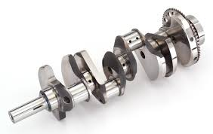
Mechanical Components
Crank Shaft uses many Cams on it
Vishwakarma Institute of Technology
FY - Department of Engineering, Sciences and Humanities

Slide 17
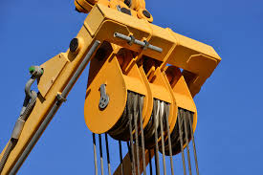
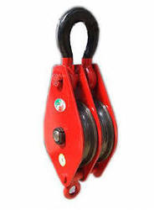
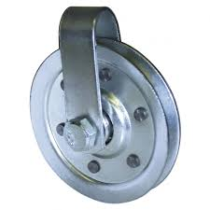
Mechanical Components
Vishwakarma Institute of Technology
FY - Department of Engineering, Sciences and Humanities
Pulleys

Slide 18
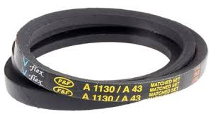
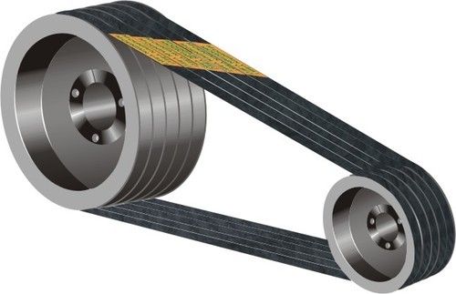
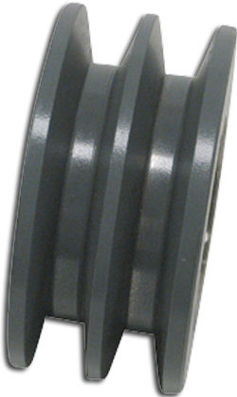
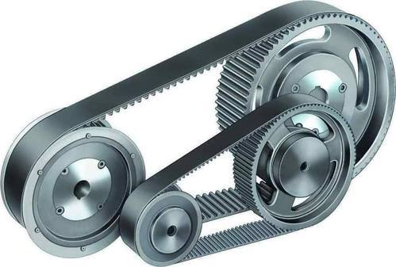
Mechanical Components
Flat Belt
‘V’ Belt and Pulley
Timing Belt
Vishwakarma Institute of Technology
FY - Department of Engineering, Sciences and Humanities

Slide 19
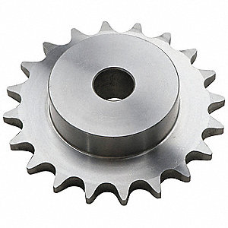
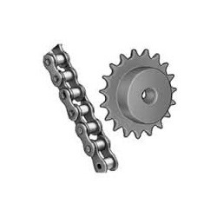
Mechanical Components
Vishwakarma Institute of Technology
FY - Department of Engineering, Sciences and Humanities
Chain and Sprocket

Slide 21
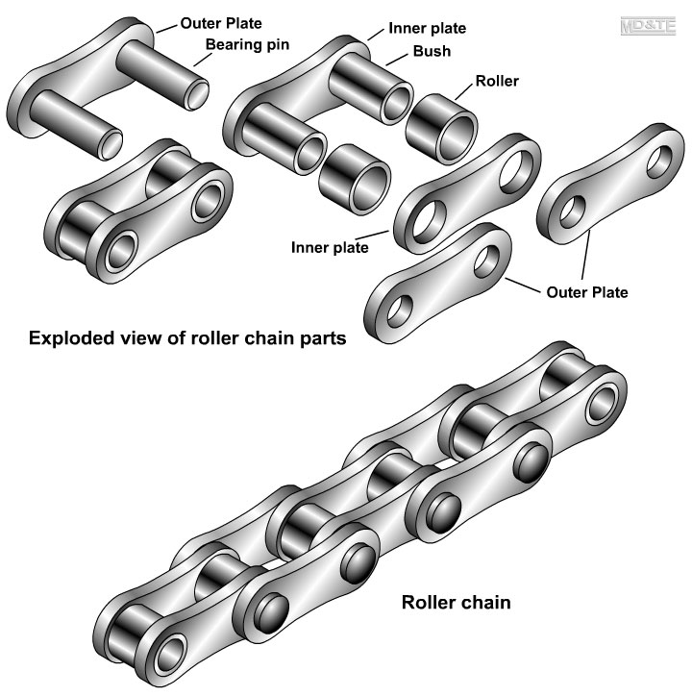
Mechanical Components
Chain and spare parts
Vishwakarma Institute of Technology
FY - Department of Engineering, Sciences and Humanities

Slide 22
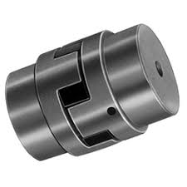
Mechanical Components
Vishwakarma Institute of Technology
FY - Department of Engineering, Sciences and Humanities
Coupling – to couple two shafts

Slide 23
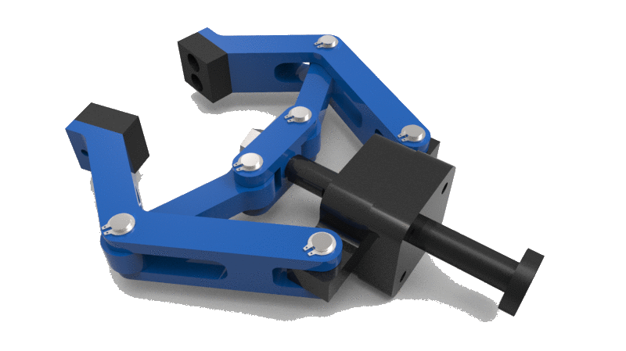
Mechanical Components
Gripper (End effecter)
Vishwakarma Institute of Technology
FY - Department of Engineering, Sciences and Humanities

Slide 24
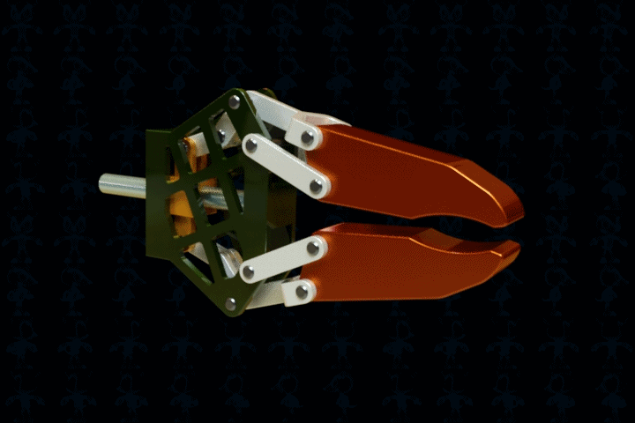
Mechanical Components
Gripper (End effecter)
Vishwakarma Institute of Technology
FY - Department of Engineering, Sciences and Humanities

Slide 25
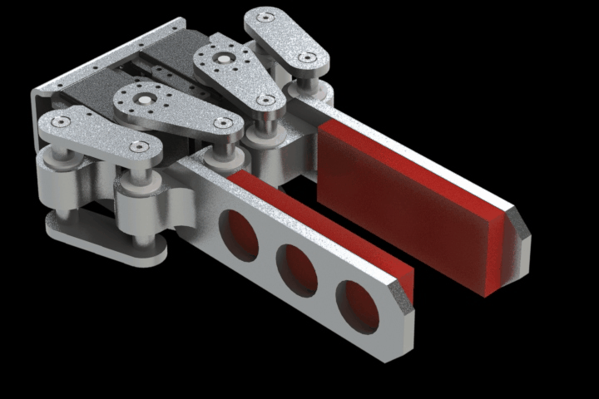
Mechanical Components
Gripper (End effecter)
Vishwakarma Institute of Technology
FY - Department of Engineering, Sciences and Humanities

Slide 26
Thanks !
Mechanical Components – 2
FY – DESH – VIT
Vishwakarma Institute of Technology
FY - Department of Engineering, Sciences and Humanities

